Slide 1
The Role of a Lab Director in Today’s Community Colleges
Mutasem Sweis, MS
Physical Sciences Laboratory Director
Moraine Valley Community College
Palos Hills, IL
Notes:
Good morning and welcome everyone. I would like to thank our Cochairs Roger and Dan for inviting me and allowing me to present and Harper College for hosting this enjoyable and informative conference. Thank all of you for coming today. I hope that my presentation is helpful for you. I expect to have time at the end for questions, but feel free to interrupt if you have a question.

Slide 2
Overview of Today’s Discussion
Past few years role has transformed
Gradual and unintentional transformation
Notes:
…
As the number of students has increased, and we even moved into new facilities, the number of faculty and staff has not. As a result, everyone was expected to do more with less resources and the same amount of time. Honestly, either I had to do things that were normally done by others, or they simply would not be done. Too much was being asked by too few people. Fortunately, I had or developed the skills needed, and it was the case, and I don’t mean to brag, for our department of the right person being at the right place at the right time. The job description had to change and I was able to step up to what became, fundamentally, a new position.

Slide 3
Transformation Budget-Driven
Dean, Department Chair, and Full-Time Faculty have been asked to accept more responsibilities. Lab Director has had the opportunity to pick up additional responsibilities that additional full-time employees might have held.
Increased Enrollment
New Facilities

Slide 4
Transformation Driven by Self
Had the qualifications to change the official description of the position
Nature of position was modified so significantly that the salary track was changed

Slide 5
In the Past
Behind the Scenes
As if in a fairy tale, faculty would come to their laboratory section and everything needed for an experiment would be prepared on a cart for them, chemicals and equipment … magically.
Cart appears, disappears, other supplies in lab restocked between classes if needed, spills magically disappear.

Slide 6
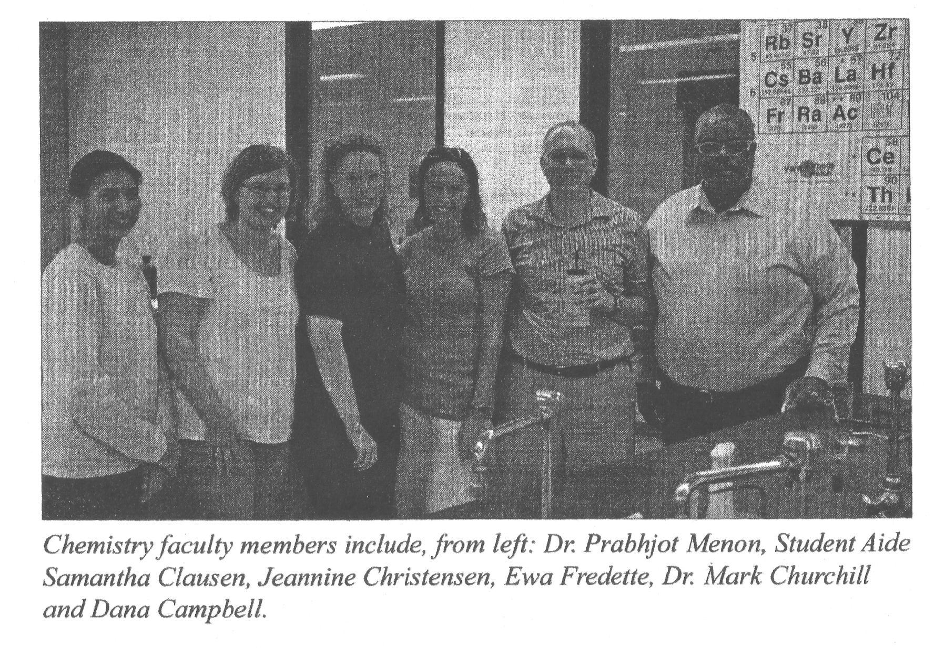
MVCC Official Newsletter
Notes:
Please excuse the resolution, but this came from our campus newsletter, and so I had to take a small photo and increase its size dramatically. What I want you to notice is that I am not even present in this old official department photograph. My student assistant is, but I am not. I can read for you the caption…

Slide 7
Very limited direct interaction with students and faculty
Notes:
We were friendly and cordial. I was helpful and supportive, but, in general, we worked within different realms.

Slide 8
Original Work Functions
Preparing carts for experiments
Developing emergency procedures and directing operations for any clean up and disposal of spills and/or leaks of hazardous materials
Posting, hiring, training, managing, mentoring and evaluating student aides. Personal mission of mine. Emphasis on development of critical-thinking skills.
Notes:
I already discussed the nature of the first function, to prepare the experiment carts for each experiment for each course that is taught at Moraine Valley. Most courses have multiple sections, so the carts must be constantly restocked with chemicals and supplies.
Second function may have been most critical, that is making sure the students of the college were safe while they were in the physical sciences laboratories. And that function, as you know, becomes more and more complex as regulations change and we learn more about the risks of specific chemicals. Our concerns as colleges about our students become more and more complicated, as do our liabilities.
The third area was and is one of my favorites. I always stressed solving problems with my student aids together in such a way that their critical thinking skills were refined. That is always important to me because it is a skill they can use in any career. You should know that at least one of my student aids has already advanced to become a faculty member.

Slide 9
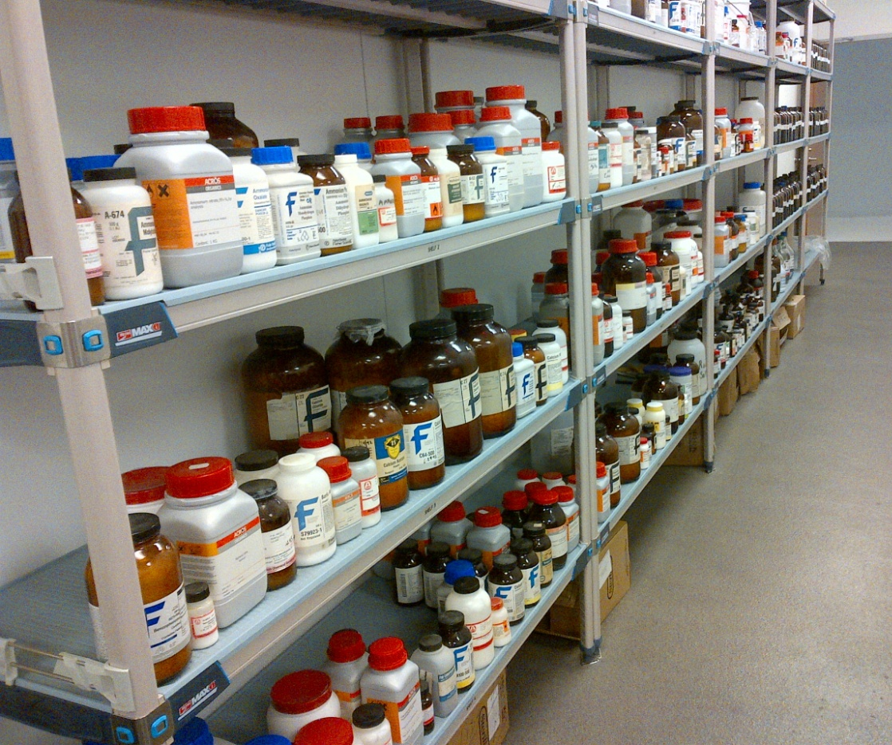
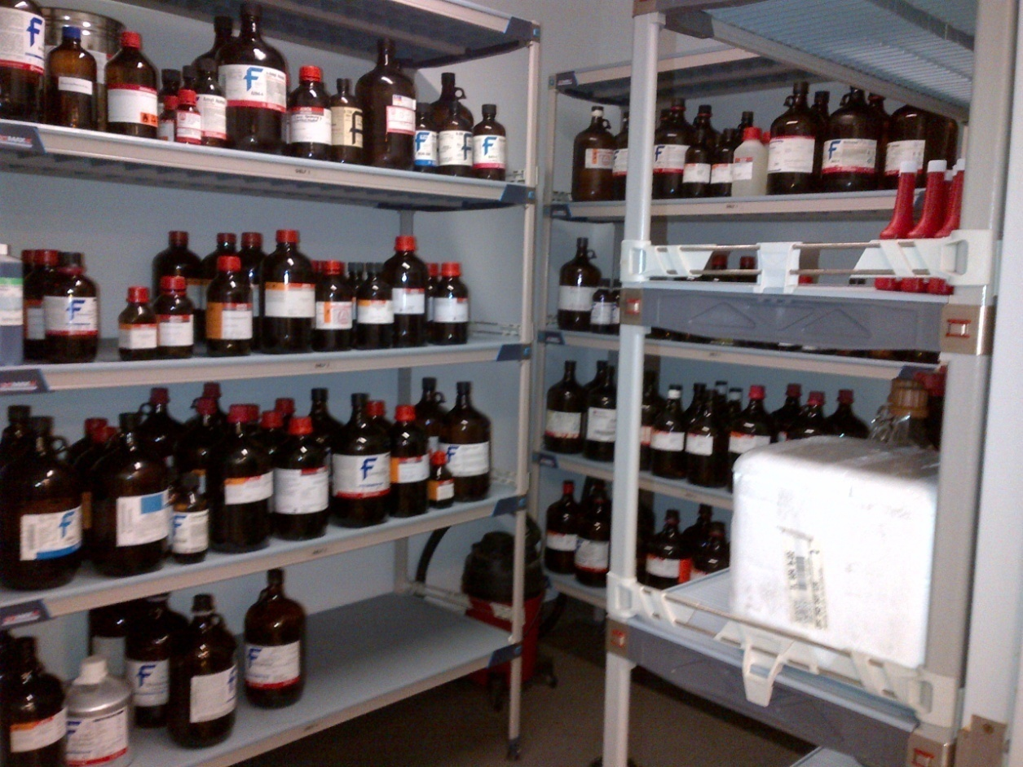
Maintaining inventory of all materials and capital goods
Notes:
Fraction of our chemicals

Slide 10
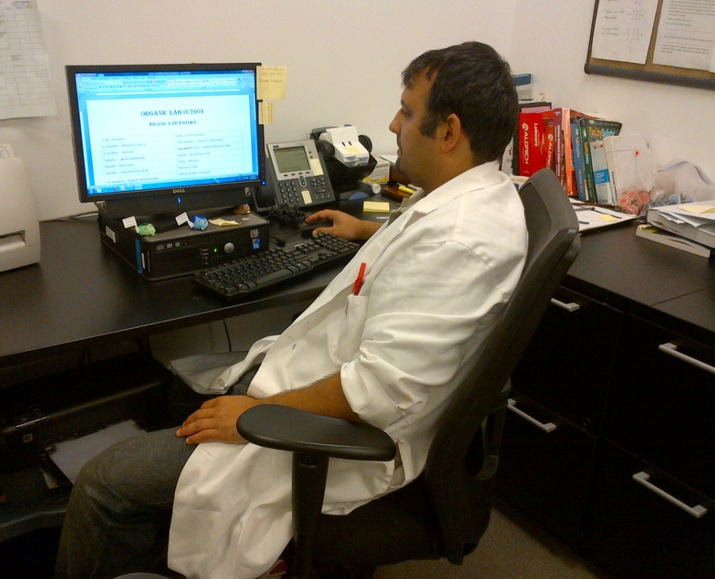
Purchasing Supplies and Materials within Budget
Meeting Budget Constraints Becoming More Difficult as State Funding has Decreased

Slide 11
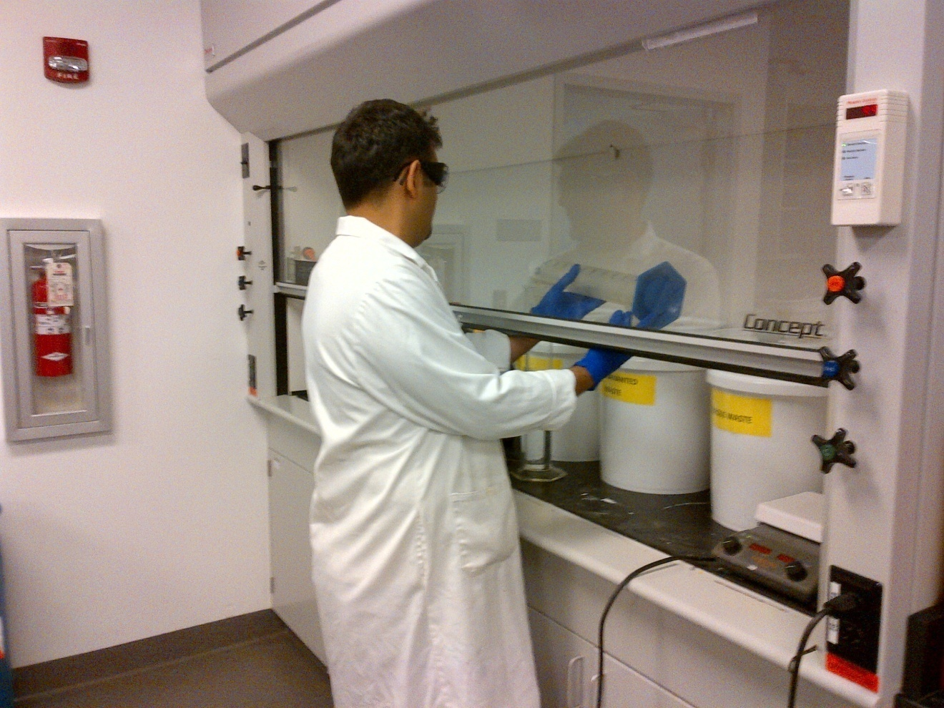
Making solutions

Slide 12
Past Few Years Responsibilities and Role has Changed Drastically Original Functions AND Additional Ones.
Notes:
Significant changes

Slide 13
Job Qualifications
Previously
Few chemistry classes
Currently
Associates Degree
Computer Skills
Basic Electronics
Mechanical Skills
Basic Accounting Skills
Audio/Visual Tech Skills
Interpersonal Communication Skills

Slide 14
Now an Equal and Integral Part of Department

Slide 15
Interaction with Students
Alternative Mentor for Students
Different Perspective during discussions about the lab material with students (for example how to set up needed calculations)
Does not replace faculty, but offers students an additional layer of support

Slide 16
Direct Interaction with Students, 2
My hands-on work responsibilities helps students from surrounding blue-collar community relate to me. UPS is a primary area employer.
Students easily relate to me because I grew up in this area.
“Someone like me can make it!” Shows success in the field of chemistry.

Slide 17
Direct Interaction with Students, 3
FAMILIAR FACE FOR RETURNING STUDENTS, REGARDLESS OF WHAT CLASSES THEY ARE TAKING

Slide 18
Another Set of Eyes & Ears
Sometimes Visible - an alternative MVCC authority for students to approach with questions - doors always open, both to hallway and to lab rooms, no “office hours”
Sometimes Invisible - often overhears or sees events in the laboratories that students would not allow a faculty member to hear or see - also an asset
Notes:
When seen, students can approach with questions.
When unseen, can overhear conversations that faculty might miss because students would hesitate to allow a faculty member to hear them say that they were confused regarding the material.

Slide 19
Pipeline for Student Input
Spend time conversing with students taking chemistry courses in order to evaluate the difficulty level of the labs written
Students express if the labs are written in such a manner that they can navigate their way through the lab procedures without much difficulty
Consults with faculty members regarding student comprehension of the mechanics and understanding of the concepts of all labs that are performed. Contributes to discussions regarding Assessment of Student Academic Achievement.

Slide 20
Adds Diversity to Department
Unique Ethnicity within Full Timers
Unique Bilingual within Full Timers
Grew up Locally, Most did not
Apparent Socioeconomic Status from hands-on job with which students are able to relate

Slide 21
STRONGER VOICE in Modifying Curriculum
Some faculty may be unaware of latest safety and environmental regulations
Some faculty may be unaware of procurement difficulties (supplier side) or of budget restraints
Some faculty may be unaware of difficulties adjunct faculty are having teaching specific experiments
Valuable Asset in Laboratory Curriculum Discussions
Notes:
Used to be ONLY faculty and chair were part of these discussions.

Slide 22
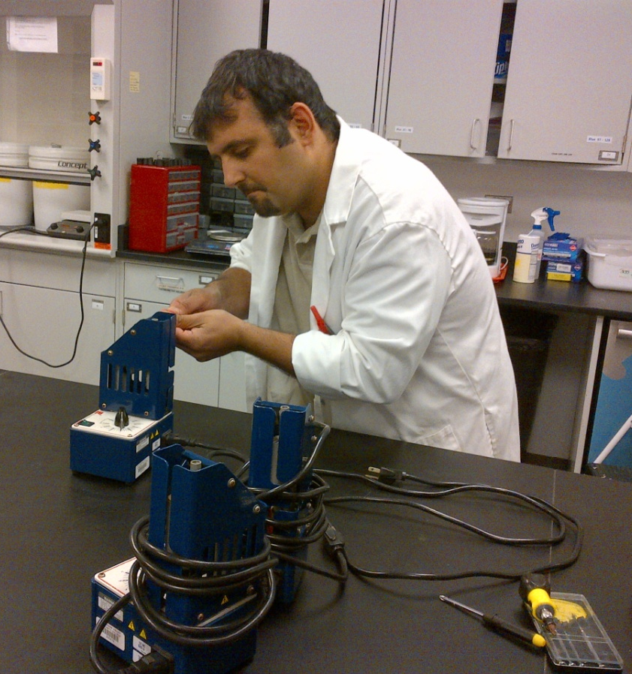
Repairing broken items and/or locating companies to repair broken items
Centrifuges
Melting Temperature Devices
Balances
Scales
Microscopes (Sent out for repair)

Slide 23
Modernizes Labs for Safety and Cost Efficiency
Identification of Selected Anions
Carbon Tetrachloride had been originally used
Due to its high toxicity, changed to decane
A few months later, decane was replaced with heptane as heptane was more cost effective
Personal Involvement of Lab Director in Lab Curriculum Choices Made Modifications Possible
Notes:
It was MY PERSONAL INVOLVEMENT that allowed these changes to happen. In the past, these changes were only made by faculty and the department chair.

Slide 24
Adjunct Orientation for Experiments
Cannot be done by the department chair
Must be done for almost each experiment for each new instructor (adjuncts may not have done lab as undergrad or grad student or in previous positions)
High turn-over for adjuncts even for the best two-year colleges
Introduction to an experiment (protocol, safety, waste disposal) often must be done within a five minute period (between labs)
Requires a staff member with a flexible schedule, who can help immediately

Slide 25
Laboratory Demonstrations
Has Done ALL experiments in curriculum
Critical for first year instructors (may not have done lab as undergrad or grad student or in previous positions)
Needed for complex demonstrations which require two instructors due to the nature of the experiment or due to safety concerns
Example: Oxygen lab, extensive preparation, safety with sharp glass & oxygen and open flames, drainage tubes which can flood the lab, thistle tubes which may become clogged

Slide 26
STEM Student Research Program
Several presentations about STEM during this conference. Science, Technology, Engineering, and Mathematics Student Research Poster Competition Program
Briefly, at MVCC, we often have 7 different experiments going on by 28 students, simultaneously, supervised supposedly by one faculty member. Obviously, that doesn’t work.
Also, the experiments are student-designed, change on the spot, and I never know what they are in advance.

Slide 27
STEM Program, 2
Provides conventional and unusual equipment (such as motor oil or cheesecloth, with little or no notice)
Gives general advice regarding projects (which electronic balance to use, what solvent to use…)
Consults regarding safety concerns, such boiling off organic solvents in a water bath rather than over an open flame.
Oversees actual experiments, especially when two labs are needed due to computers being in one lab and hoods in another.
Requires a staff member with a flexible schedule who can help immediately
Notes:
Cheesecloth is a reusable filtering material, like filter-paper but can be washed and reused.

Slide 28
CHEM Connections*
Promotes science education in elementary schools
Demonstrates the countless ways chemistry touches our lives
Geared toward third, fourth, fifth and sixth graders
International program teaches students about science through hands-on experimentation
*from CHEM Connections Materials

Slide 29
CHEM Connections, 2
The lab director along with trained employee ambassadors visits local schools to conduct extraordinary experiments using ordinary household products to develop enthusiasm for science and to demonstrate scientific principles
This program reaches to the communities in order to built trust among our neighbors, while providing a valuable services to area schools
Requires staff with a flexible schedule

Slide 30
Consultant for All Faculty
Fundamentals of Chemistry
Chemistry (University Oriented) I
Chemistry (University Oriented) II
Organic Chemistry I
Organic Chemistry II
Consistent Factor for all Experiments for all Classes

Slide 31
New Lab Director
Role Different from that of a Full Time Faculty Member
Role Different from that of an Adjunct Faculty Member
Not Department Chair

Slide 32
Role Different from that of a Full Time Faculty Member
FLEXIBLE SCHEDULE
ACCESS TO INFORMATION (PRICING, AVAILABILITY, ABILTY TO MAKE SPECIAL DEALS)
BRANCH NEUTRAL (DOES NOT FAVOR ORGANIC OVER GENERAL…)
APOLITICAL
OFTEN PERCEIVED TO BE MORE ACCESSIBLE TO STUDENTS THAN A FACULTY MEMBER WHO ASSIGNS GRADES (no risk if question seems “stupid”)

Slide 33
NOT ADJUNCT
THERE ALL THE TIME, CONSISTENT PRESENCE
HAS A BETTER UNDERSTANDING OF WHAT IS WORKING OR NOT WORKING FOR THE ENTIRE DEPARTMENT, NOT JUST FOR INDIVIDUAL INSTRUCTORS

Slide 34
NOT THE CHAIR
HAS TIME FOR NEW HIRES
CAN TRAIN NEW ADJUNCTS AND NEW FULL-TIMERS
IS APOLITICAL
IS NOT USUALLY PROMOTED “UP THE ADMINISTRATIVE LADDER”

Slide 35
In conclusion… the New Lab Director
ADDS DIVERSITY
ADDS EXPERIENCE, KNOWLEDGE
ADDS DIFFERENT IDEAS, PERSPECTIVE
LOOKS DIFFERENT TO STUDENTS THAN FACULTY DO
GIVES DEPARTMENT SENSE OF CONTINUITY and PERMANENCE

Slide 36
NEW LAB DIRECTOR
Additional ingredient in the department which is needed for the department to excel
Aids in Bettering the Department
Helps to Complete a Community of Scholars (Administration, faculty, staff, and students learning and working together to encourage each other).
Creates a better environment for everyone and is a excellent role model for students.

Slide 37
Notes:
The Lab Director has meaningful relationships with so many individuals in and around the department. He or she now becomes the hub of a well-functioning department. Not the head, but the hub.

Slide 38
Special thanks to Dan Stanford and Roger House for coordinating this conference and to Harper College for hosting it. Special thanks to Pam Goodman, who encouraged me to share my experiences at MVCC with you and helped me create this presentation. And, finally, THANK YOU for your attention during my presentation.

Slide 39
Thank you.
Mutasem Sweis
708.608.4104
Sweis@morainevalley.edu

